Slide 1
Encoding Techniques in Genetic Algorithms

Slide 2
Working of Genetic Algorithm
Definition of GA:
Genetic algorithm is a population-based probabilistic search and optimization techniques, which works based on the mechanisms of natural genetics and natural evaluation.

Slide 3
Framework of GA
Start
Note:
An individual in the population is corresponding to a possible solution
Initial Population
No
Selection
Converge?
Yes
Reproduction
Stop

Slide 4
Working of Genetic Algorithm
Note:
GA is an iterative process. It is a searching technique.
Working cycle with / without convergence.
Solution is not necessarily guranteed. Usually, terminated with a local optima.
1
2
3
4

Slide 5
Framework of GA: A detail view
Start
Define parameters
Parameter
Representation
function to each of the population
Initialize population
Create population
Apply cost
No
Evaluate the fitness
S e l e c t i o n
Converge ?
Yes
Select Mate
Stop
R e p r o d u c t i o n
Crossover
Mutation
Inversion

Slide 6
Optimization problem solving with GA
For the optimization problem, identify the following:
Objective function(s) Constraint(s)
Input parameters
Fitness evaluation (it may be algorithm or mathematical formula) Encoding
Decoding

Slide 7
GA Operators
In fact, a GA implementation involved with the realization of the following operations.
Encoding: How to represent a solution to fit with GA framework.
Convergence: How to decide the termination criterion.
Mating pool: How to generate next solutions.
Fitness Evaluation: How to evaluate a solution. Crossover: How to make the diverse set of next solutions. Mutation: To explore other solution(s).
Inversion: To move from one optima to other.

Slide 8
Different GA Strategies
Simple Genetic Algorithm (SGA)
Steady State Genetic Algorithm (SSGA) Messy Genetic Algorithm (MGA)

Slide 9
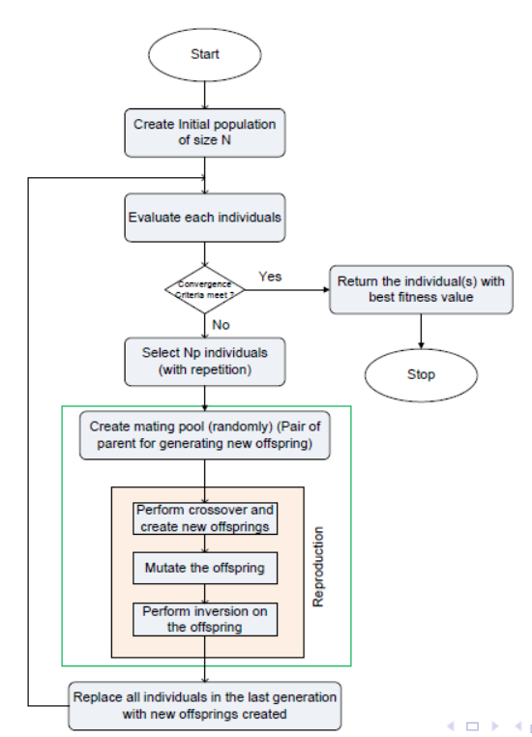
Simple GA

Slide 10
Important parameters involved in Simple GA
SGA Parameters
Initial population size : N
Size of mating pool, N_{p} : N_{p} = p%of N
Convergence threshold δ
Mutation µ Inversion η Crossover ρ

Slide 11
Salient features in SGA
Simple GA features:
Have overlapping generation (Only fraction of individuals are replaced).
Computationally expensive.
Good when initial population size is large. In general, gives better results.
Selection is biased toward more highly fit individuals; Hence, the average fitness (of overall population) is expected to increase in succession.
The best individual may appear in any iteration.

Slide 12
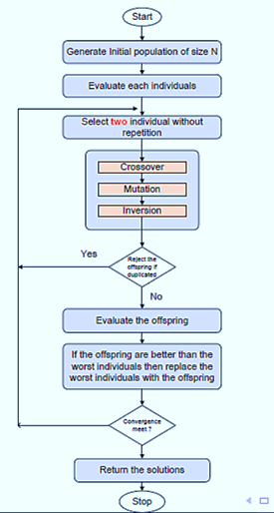
Steady State Genetic Algorithm (SSGA)

Slide 13
Salient features in Steady-state GA
SGA Features:
Generation gap is small.
Only two offspring are produced in one generation.
It is applicable when
Population size is small Chromosomes are of longer length
Evaluation operation is less computationally expensive
(compare to duplicate checking)

Slide 14
Salient features in Steady-state GA
Limitations in SSGA:
There is a chance of stuck at local optima, if crossover/mutation/inversion is not strong enough to diversify the population).
Premature convergence may result.
It is susceptible to stagnation. Inferiors are neglected or removed and keeps making more trials for very long period of time without any gain (i.e. long period of localized search).

Slide 15
GA Operators
Following are the GA operators in Genetic Algorithms.
Encoding Convergence test Mating pool Fitness Evaluation Crossover Mutation
Inversion
1
2
3
4
5
6
7

Slide 16
Different Encoding Schemes
Different GAs
Simple Genetic Algorithm (SGA) Steady State Genetic Algorithm (SSGA) Messy Genetic Algorithm (MGA)
Encoding Schemes
Binary encoding Real value encoding Order encoding Tree encoding

Slide 17
Different Encoding Schemes
Often, GAs are specified according to the encoding scheme it follows.
For example:
Encoding Scheme
Binary encoding –> Binary Coded GA or simply Binary GA Real value encoding –> Real Coded GA or simply Real GA Order encoding –> Order GA (also called as Permuted GA) Tree encoding

Slide 18
Encoding Schemes in GA
Genetic Algorithm uses metaphor consisting of two distinct elements :
1
Individual
Population
2
An individual is a single solution while a population is a set of individuals at an instant of searching process.

Slide 19
Individual Representation :Phenotype and Genotype
An individual is defined by a chromosome. A chromosome stores genetic information (called phenotype) for an individual.
Here, a chromosome is expressed in terms of factors defining a problem.
Genotype
Factor 1 |  | Factor 2 |  | …. | Factor n
Gene 1 | Gene 2 | …. | Gene n
Phenotype
a b c 1 0 1 2 9 6 7 $ α β . . . . . . . . . . . . . . . . . .

Slide 20
Individual Representation :Phenotype and Genotype
Note :
A gene is the GA’s representation of a single factor (i.e. a design parameter), which has a domain of values (continuous, discontinuous, discrete etc.) symbol, numbering etc.
In GA, there is a mapping from genotype to phenotype. This eventually decideds the performance (namely speed and accuracy) of the problem solving.

Slide 21
Encoding techniques
There are many ways of encoding:
1
Binary encoding: Representing a gene in terms of bits (0s and 1s).
Real value encoding: Representing a gene in terms of values or symbols or string.
Permutation (or Order) encoding: Representing a sequence of elements)
Tree encoding: Representing in the form of a tree of objects.
2
3
4

Slide 22
Binary Encoding
In this encoding scheme, a gene or chromosome is represented by a string (fixed or variable length) of binary bits (0’s and 1’s)
A :
0 1 1 0 0 1 0 1 0 1 0 1 0 1 1 1 1 0
Individual 1
B :
0 0 1 0 1 0 1 1 1 0 1 0 1 0 1 0 0 0
Individual 2

Slide 23
Example: 0-1 Knapsack problem
There are n items, each item has its own cost (c_{i} ) and weight (w_{i} ).
There is a knapsack of total capacity w .
The problem is to take as much items as possible but not exceeding the capacity of the knapsack.
This is an optimization problem and can be better described as follows.
Maximize :
^{Σ}_{i} c_{i} ∗ w_{i} ∗ x_{i}
^{Σ} x_{i} ∗ w_{i} ≤ W
Subject to
where x_{i} ∈ [0 · · · 1]

Slide 24
Example: 0-1 Knapsack problem
Consider the fallowing, an instance of the 0-1 Knapsack problem.
I2
I3
50
I1
30
Max. Weight 50
20
10
$60
$100
$120
Knapsack
Brute force approach to solve the above can be stated as follows:
Select at least one item
[10], [20], [30], [10, 20], [10, 30], [ 20, 30], [10, 20, 30]
So, for n-items, are there are 2^{n} − 1 trials.
0 - means item not included and 1 - means item included
[100], [010], [011], [110], [101], [011], [111]

Slide 25
Example: 0-1 Knapsack problem
The encoding for the 0-1 Knapsack, problem, in general, for n items set would look as follows.
Genotype :
1
2
3
4
. . . . .
. . . . .
n-1
n
Phenotype :
0 1 0 1 1 0 1 0 1 0 1 0 1. . . . . .1 0 1
A binary string of n-bits

Slide 26
Few more examples
Example 1 :
Minimize :
f (x ) = ^{x 2} + ¹²⁵
2 x
where 0 ≤ x ≤ 15 and x is any discrete integer value.
Genotype :
x
Phenotype :
0 1 1 0 1
A binary string of 5-bits

Slide 27
Few more examples
Example 2 :
Maximize :
f (x, y ) = x ³ − x ²y + xy ² + y ³
x + y ≤ 10
Subject to :
and
1 ≤ x ≤ 10
−10 ≤ y ≤ 10
Genotype :
x
y
Phenotype :
0 1 1 0 1
1 1 0 0 1
Two binary string of 5-bits each

Slide 28
Pros and cons of Binary encoding scheme
Limitations:
Needs an effort to convert into binary from Accuarcy depends on the binary reprresentation
1
2
Advantages:
1
Since operations with binary represntation is faster, it provide a faster implementations of all GA operators and hence the execution of GAs.
Any optimization problem has it binary-coded GA implementation
2

Slide 29
Real value encoding
The real-coded GA is most suitable for optimization in a continuous search space.
Uses the direct representations of the design paparmeters. Thus, avoids any intermediate encoding and decoding steps.
Genotype :
x
y
Phenotype :
5.28
-475.36
Real-value representation

Slide 30
Real value encoding with binary codes
Methodology: Step 1 [Deciding the precision]
For any continuous design variable x such that X_{L} ≤ x ≤ X_{U} , and if ε is the precision required, then string length n should be equal to
n = log
X −X
2
U L
ε
where X_{L} ≤ x ≤ X_{U}
Equivalently,
ε =
X −X
U L
2
n
In general, ε = [0 · · · 1]. It is also called, Obtaianable accuracy
Note:If ε = 0.5, then 4.05 or 4.49 ≡ 4 and 4.50 or 4.99 ≡ 4.5 and so on.

Slide 31
Real value encoding: Illustration 1
Example 1:
1 ≤ x ≤ 16, n = 6. What is the accuracy?
1
ε =
16−1 15
= = 0.249 ≈ 0.25
6
2 64
Example 2:
What is the obtainable accuracy, for the binary representation for a variable X in the range range 20.1 ≤ X ≤ 45.6 with 8-bits?
Example 3:
In the above case, what is the binary representation of X = 34.35?
2
3

Slide 32
Real value encoding with binary codes
Methodology: Step 2 [Obtaining the binary representation]
Once, we know the length of binary string for an obtainable accuracy (i.e precision), then we can have the following mapping relation from a real value X to its binary equivalent decoded value X_{B} ,which is given by
X = X +
X −X
× X
L
U L
B
2^{n}−1
where X_{B} = Decoded value of a binary string, n is the number of bits in the representation, X_{L} → 0 0 0 0 · · · 0 and
X_{U} → 1 1 1 1 · · · 1
are the decoded values of the binary representation of the lower and upper values of X .

Slide 33
Real value encoding: Illustration 2
Example:
Suppose, X_{L} = 2 and X_{U} = 17 are the two extreme decoded values of a variable x .
n = 4 is the number of binary bits in the representation for x.
X_{B} = 10(= 1 0 1 0) is a decoded value for a given x . What is the value of x =? and its binary representation??
Here, x = 2 +
17−2
× 10 = 12
2⁴−1
Binary representation of x = 1 1 0 0

Slide 34
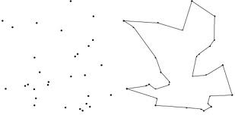
Order Encoding
Let us have a look into the following instance of the Traveling Salesman Problem (TSP).
All cities are to be visited
A possible tour
TSP
Visit all the cities
One city once only
Starting and ending city is the same
How we can formally define the TSP?

Slide 35
Order Encoding for TSP
Understanding the TSP:
There is a cost of visiting a city from another city and hence the total cost of visiting all the cities but exactly once (except the starting city).
Objective function: To find a tour (i.e. a simple cycle covering all the cities) with a minimum cost involved.
Constraints:
All cities must be visited.
There will be only one occurrence of each city (except the starting city).
Design parameters:
Euclidean distance may be taken as the measurement of the cost, otherwise, if it is specified explicitly.
The above stated information are the design variables in this case.
We are to search for the best path out of n! possible paths.

Slide 36





A small instance of the TSP
A
d | A | B | C | D | E
A | 0 | 2 | ∝ | 6 | 4
B | 2 | 0 | 7 | ∝ | 5
C | ∝ | 7 | 0 | 3 | 1
D | 6 | ∝ | 3 | 0 | ∝
E | 4 | 5 | 1 | ∝ | 0
6
2
4
5
D
B
E
7
3
d= Distance matrix
C
Connectivity among cities

Slide 37
Defining the TSP
Minimizing
Σ
cost =
n−2
d (c , c
) + d (c , c )
i =0
i i +1
n−1 0
Subject to
P = [c₀, c₁, c₂, · · · , c_{n−1}, c₀]
where c_{i} ∈ X ;
Here, P is an ordered collection of cities and c_{i} /= c_{j} such that
∀i, j = 0, 1, · · · , n − 1
Note: P represents a possible tour with the starting cities as c₀.
and
X = x₁, x₂, · · · , x_{n}, set of n number of cities,
d (x_{i} , x_{j} ) is the distance between any two cities x_{i} and x_{j} .

Slide 38
Tree encoding
In this encoding scheme, a solution is encoded in the form of a binary tree.
A
D A B E G C F (In-order)
(T_{L} R T_{R})
B
C
A B D C E G F (Pre-order)
(R TL TR)
D B G E E C A (Post-order) (TL TR R)
D
E
F
G
A binary tree
Three compact representation

Slide 39
Floor Planning : An example of tree encoding
Floor planning is a standard problem in VLSI design. Here, given n circuits of different area requirements, we are to arrange them into a floor of chip layout, so that all circuits are placed in a minimum layout possible.
C₂
C₁
C₂
C₃
C₉
C₅
C₁
C₇
C₅
C₆
C₄
C₈
C₄
C₆
C₈
C₇
C₉
C10
C₃
10 circuits
A floor plan

Slide 40
Formulation of floor planning problem
A possible formulation of Floor planning problem of VLSI circuit is as follows.
Given :
1
A set of n rectangular blocks B = b₁, b₂, · · · , b_{i} , · · · , b_{n}
For each b_{i} ∈ B, we have the following specification:
the width w_{i} and height h_{i} (which are constant for rigid blocks and variable for flexible blocks)
2
1 h
ρ , the desirable aspect ratio about where ≤ ≤ ρ , where
i
i
i
ρ_{i} = 1, if the block b_{i} is rigid.
a_{i} = w_{i} × h_{i} , the area of each block b_{i} .
ρ_{i} w_{i}

Slide 41
Formulation of floor planning problem
3
A set of nets N = {n₁, n₂, · · · , n_{k} } describing the connectivity
information.
Wire = f₁(B, N)
1 H
4
Desirable floor plan aspect ratio ρ such that ≤ ≤ ρ
, where H
ρ W
and W are the height and width of the floor plan, respectively.
Area = f₂(B, N, ρ)
5
Timing information.
Delay = f₃(B, N, ρ)

Slide 42
Formulation of Floor planning problem
ratio constraint.
Objectives :
We are to find a floor plan, which would
A legal floor plan is a floor plan that satisfies the following constraints.
Constraints :
3
Each block b_{i} is assigned to a location say (x_{i} , y_{i} ).
No two blocks overlap
4
5
For each flexible block say b_{i} , a_{i} = w_{i} × h_{i} and should meet aspect
Minimize floor plan area.
Minimize wire length. Minimize circuit delay.
1
2
3

Slide 43
Tree encoding for Floor planning problem
1 | 3
 | 4 | 5
2
 | 6 |  | 7
1 | 4 | 5
 | 6 |  | 7
2
 | 3
Floor Plan I
Floor Plan II
1
How many floor plans are possible?
Can we find a binary tree representation of a floor plan??
2

Slide 44
Binary tree representation for floor planning
A floor plan can be modeled by a binary tree with n leaves and n − 1 nodes where
each node represents a vertical cut-line or horizontal cut-line, and Letter V and H refer to vertical and horizontal cut-operators.
each leaf node represents a rectangle blocks.

Slide 45




Example : Floor plane I
V
1 | 3
 | 4 | 5
2
 | 6 |  | 7
H
H
2
1
H
3
V
6 7 4
V
5
Floor Plan I
Binary tree representation of the floor plan I

Slide 46
Example : Floor plane I
Note 1:
The operators H and V expressed in polish notation carry the following meanings:
ijH → Block b_{j} is on top of the block b_{i} .
ijV → Block b_{i} is on the left of block b_{j} .
Note 2: A tree can be represented in a compact form using Polish notation
Note 3: Polish notation
a + b ÷ c = a + (b ÷ c) = abc ÷ +
a + b − c = ab + c−

Slide 47
Example : Floor plane I
Note 4:
Post order traversal of a binary tree is equivalent to polish notation
+
-
a
÷
a b c ÷ +
c
a b + c -
+
b
c
b
a
Note 5:
There is only one way to performing a post order traversal of a binary tree.

Slide 48




Example : Floor Plane I (with Polish notation
V
1 | 3
 | 4 | 5
2
 | 6 |  | 7
H
H
2
1
H
3
V
V
6 7 4 5
Binary tree representation of the floor plan I
Floor Plan I

Slide 49

Example : H and V operators
1
H
V₂
2
3 |  | 2
4 | V4 5 2
1
1
V
H₃
3
H₁
H
2
4
V
3
Floor Plan
4
5
Binary tree
Polish notation : 4 5 V 3 H 2 V 1 H

Slide 50

Example :Floor plan II
V
?
H
H
2
1
V
H
6
7
V
3
4
5
2 1 H 6 7 V 4 5 V 3 H H V

Slide 51

Example :Floor plan II
V
H
H
1 | 3
 | 4 | 5
2
 | 6 |  | 7
2
1
V
H
6
7
V
3
4
5
2 1 H 6 7 V 4 5 V 3 H H V

Slide 52
Problem
Problem :
How many number of solutions possible with n blocks in a floor planning problem?

Slide 53
Problem
Problem :
How many number of solutions with n blocks in a floor planning problem?
N =
1 2n
n+1 n

Slide 54
Any question??

